Slide 1

2016
ODL Hackathon
Black-Balancer
Team15 2016-1-23
John Alvin Jason

Slide 2
CONTENTS
ISSUES && WHY SDN
PROPOSE APPROACHES
TEST && EVALUATION

Slide 3
1
PART
WHY SDN
Let ODL be your eyes

Slide 4
LET ODL BE YOUR EYES
ODL Says : YES!

Slide 5
2
PROPOSE APPROACHES
PART

Slide 6
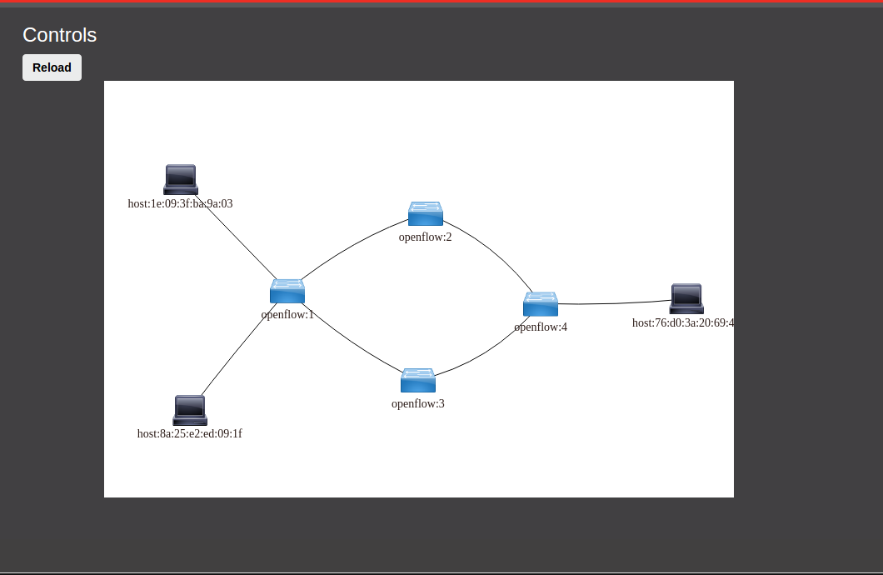
Topology
Data Flow 1
Data Flow 2

Slide 7
Application
External App
Blacklist
Load Balance
ODL
Rest API
Monitor
Openflow Plugin
OF-Switch2
HostA
OF-Switch1
OF-Switch4
HostB
OF-Switch3

Slide 8
HOW FLOW TABLE WORKS
Match | Action
Ip_address1 | Drop
Ip_address2 | Drop
………….. | ………..
Ip_address3 | TABLE
In_port | Ip_src | Ip_dst | tcp_src_port | tcp_dst_port | Action
port1 | Ip_address1 | Ip_address1 | src_port1 | dst_port1 | out_port1
port2 | Ip_address2 | Ip_address2 | src_port2 | dst_port2 | out_port2
………….. | …………. | ……………. | ……………. | ………… | ……………
portX | Ip_addressX | Ip_addressX | src_portX | dst_portX | out_portX

Slide 9
3
PART
TEST&EVALUATION

Slide 10
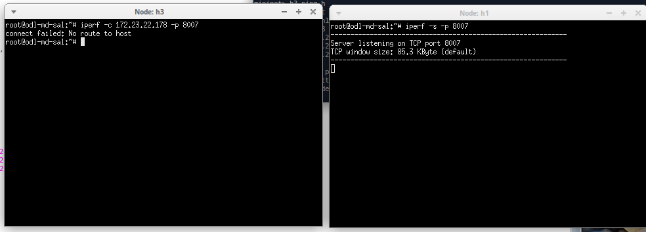
BLACK LIST

Slide 11
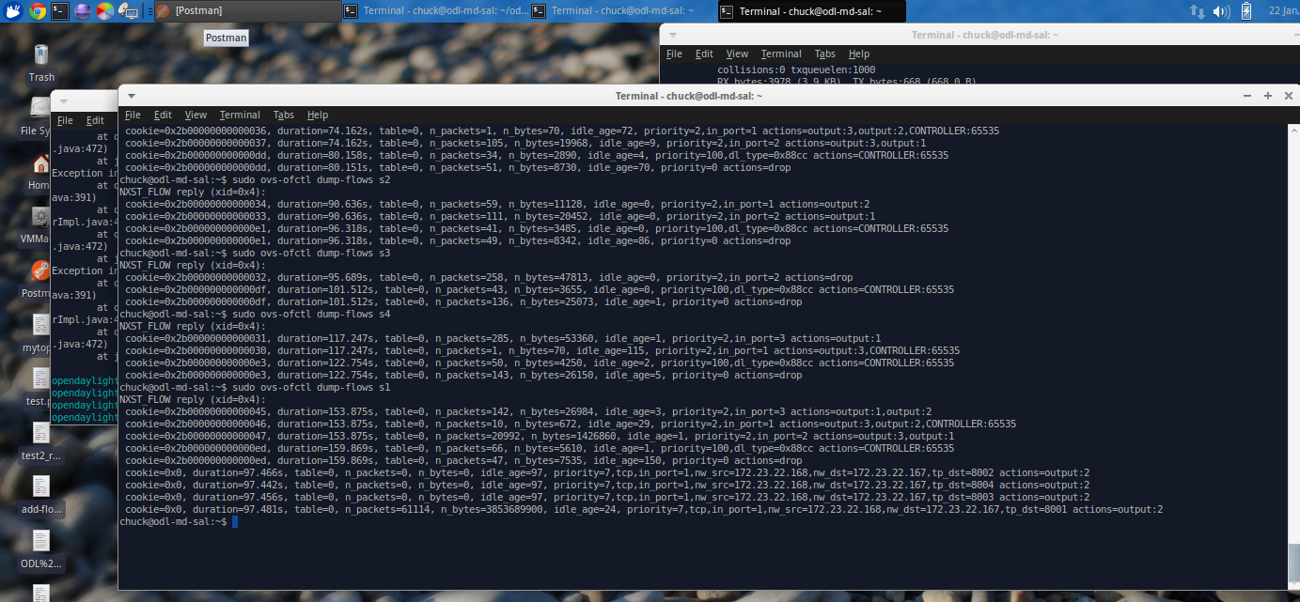
TEST Load Balance

Slide 12
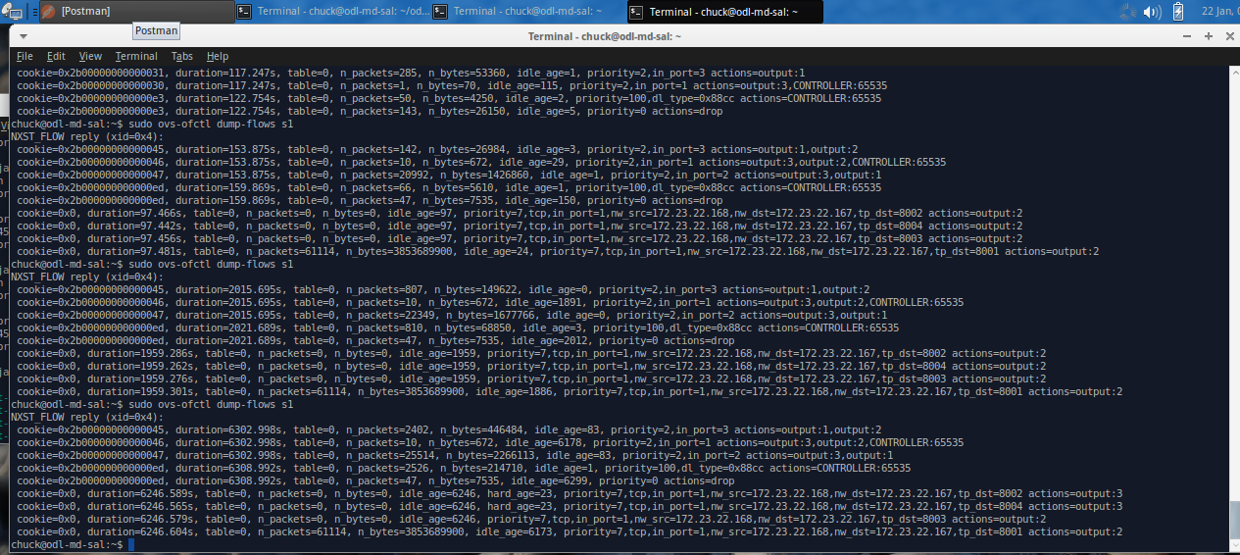
TEST Load Balance

Slide 13
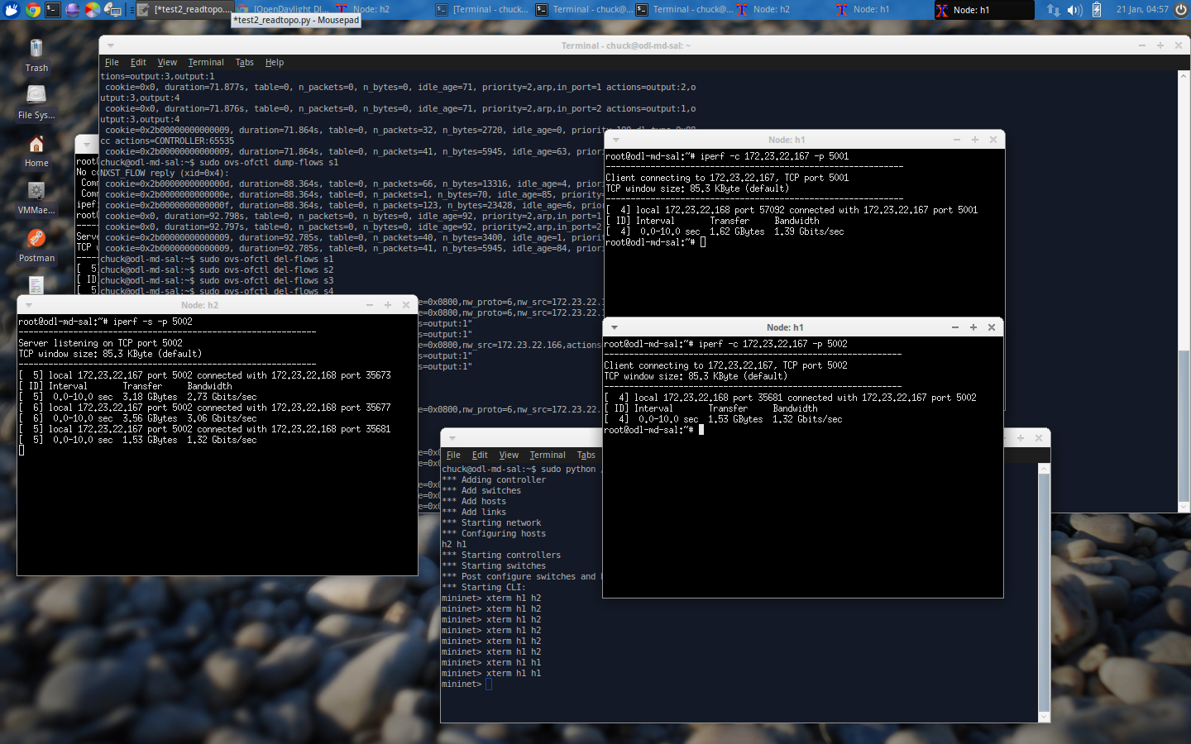
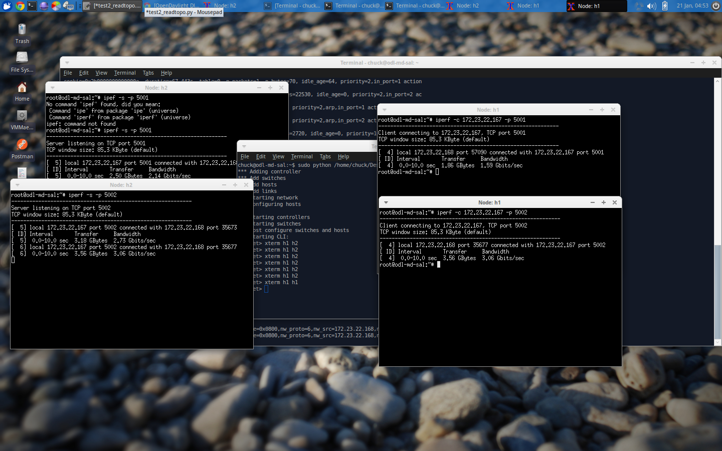
TEST Load Balance

Slide 14
THANK YOU

